Slide 1
Analysis of OncoKB API Calls
Justin Caringal & Ajay Khanna, Dr. Eric Duncavage Lab
Washington University of Saint Louis
Department of Pathology & Immunology

Slide 2
Starting Point (apldx)
Program takes input JSON file (unannotated)
Program outputs annotated JSON file
Processed further down the pipeline (PDF generation)
Also outputs .err file
Outputs statistics comparing PASS and Filtered Variants
Total, Skipped, Annotated
All calls using byGenomicChange

Slide 3
Goals
Implement similar structures using OncoKB API calls to byProteinChange and byHGVSg
Explore JSON-to-table generation and annotation
Compare API calls
Elapsed time
Successful hits

Slide 4
Example: TWJV-Gateway-Seq-S16-474-lib2.report.json
 | byGenomicChange | byProteinChange | byHGVSg
Total PASS | 7 | 7 | 7
Skipped PASS | 0 | 0 | 0
Annotated PASS | 2 | 2 | 2
Total Filtered | 26 | 26 | 26
Skipped Filtered | 0 | 0 | 0
Annotated Filtered | 3 | 3 | 3
Total Annotated | 5 | 5 | 5
Elapsed (secs) | 37.475 | 38.758 | 34.927
Implemented Elapsed time feature to be cross-compatible between machines

Slide 5
JSON-to-Table Method
JSON → annotated JSON comparison inefficient
Unique variant duplicates increases query time
Queries for each specific tumor type
JSON → table → annotated table more efficient
Removes duplicates
General query for information
Easier to analyze

Slide 6
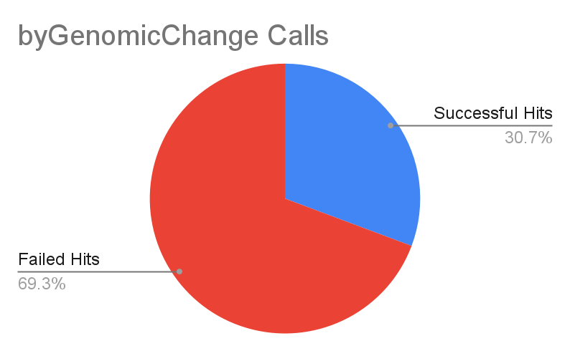
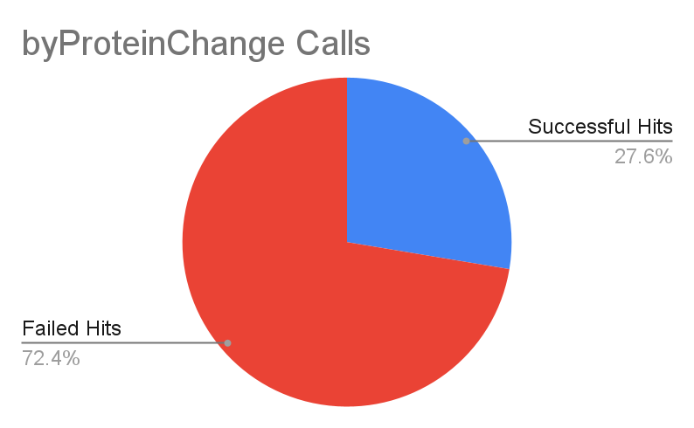
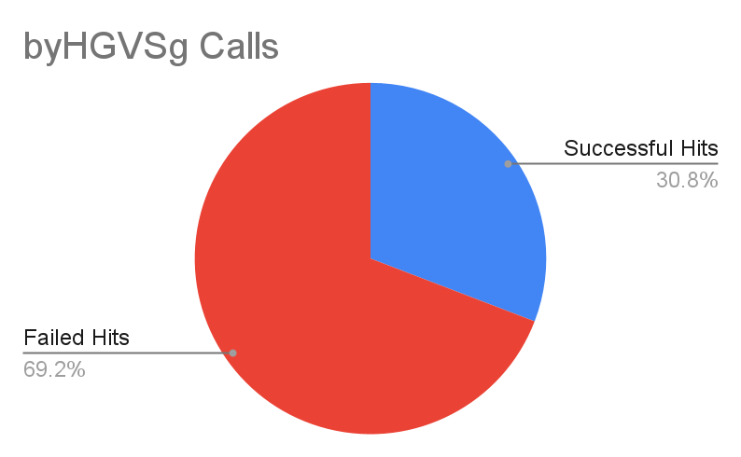
Table Annotations (142 JSON files)
 | Successful Hits | Failed Hits
Genomic | 538 | 1214
Protein | 484 | 1268
HGVSg | 540 | 1212
Total Searches | 1752
Comparisons | Differences
Genomic vs. Protein | +60
Genomic vs. HGVSg | -2
Protein vs. HGVSg | -60

Slide 7
Elapsed Time
 | byGenomicChange | byProteinChange | byHGVSg
Total (secs) | 390.918 | 299.029 | 318.2
Mean (secs) | 0.223 | 0.171 | 0.182
Variance (secs²) | 0.04379 | 0.03104 | 0.02863
Standard Deviation (secs) | 0.209 | 0.176 | 0.169
Approx. Total Elapsed Time (secs) |  |  | 1008.147
Total Elapsed, Standard Formatting |  | 16 min, 48.147 secs

Slide 8
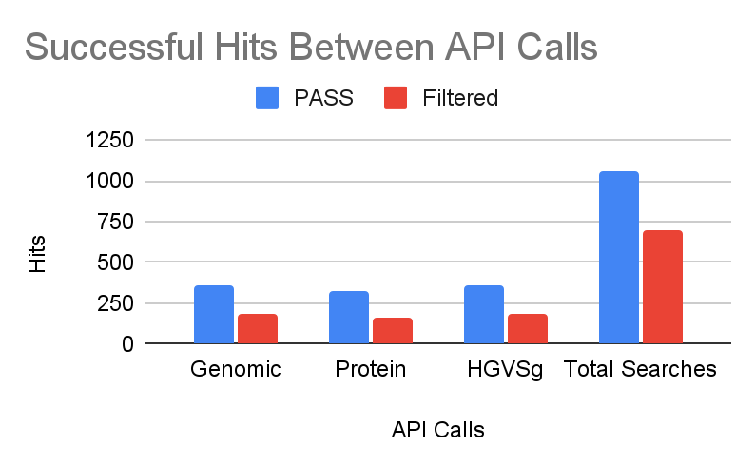
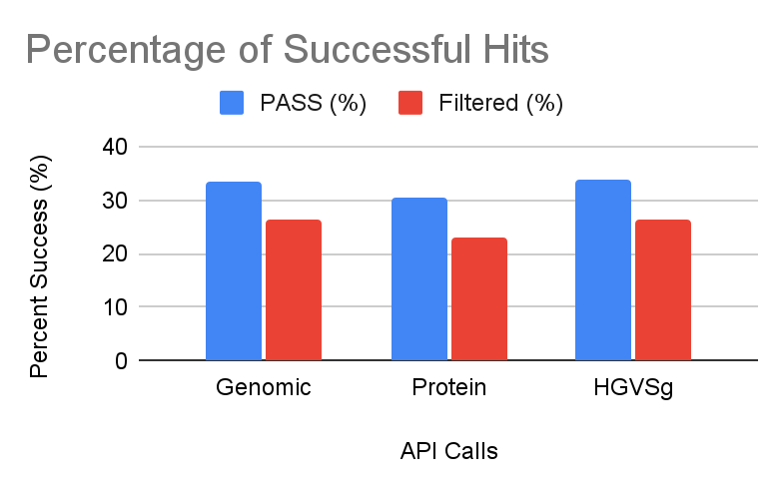
PASS vs. Filtered Variants
 | PASS | Filtered | PASS (%) | Filtered (%)
Genomic | 356 | 182 | 33.62 | 26.26
Protein | 325 | 159 | 30.69 | 22.94
HGVSg | 358 | 182 | 33.81 | 26.26
Total Searches | 1059 | 693

Slide 9
Discrepancies between the University and OncoKB
AKT1
ATM
B2M
CD79B
CHEK1
DICER1
FGFR1
HRAS
ITPKB
MYD88
NF1
NFKBIE
NTRK3
PAX8
PTPRD
RAD51B
RSPO3
SGK1
SMARCA4
SMARCB1
TCF3
TFEB
TNFAIP3
OncoKB and WashU differed in their gene-transcript pairs
Comparing with Ensembl, WashU is using the ‘canonical’ transcript (ensembl annotation canonical)
Gene/Transcript | 1752
Correct ID | 1489
Incorrect ID | 263
Discrepancy Frequency | 0.15

Slide 10
Conclusion
Overall, small differences between API calls
Protein lagged behind both Genomic and HGVSg
In cases of successful hit discrepancies (XOR)
c.syntax was used in place of p.syntax for all (60)
Complex variants may not be found using p.syntax
Other possible reasons
Transcript ID mismatch
Further investigation possible

Slide 11
Conclusion (cont’d)
HGVSg is marginally better than Genomic
Possibly down to conversion of MAF and HGVSg strings
Genes:
MET, ENST00000397752 (PASS)
SNV: T→C, unknown, possible genomicLocation syntax error
ARID1A, ENST00000324856 (PASS)
INDEL: TAG→AA, complex variant
May be possible to keep Genomic in the pipeline

